Slide 1
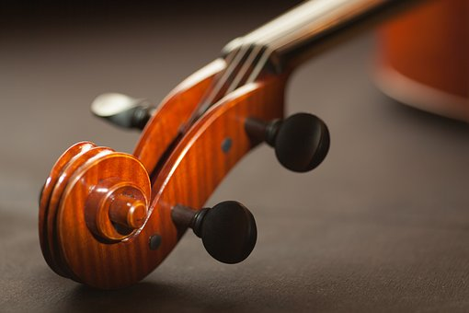
Muscleship
Kathleen A. Horvath, Ph.D.
Case Western Reserve University
kah24@case.edu

Slide 2
What is Wellness …
the state of BEING in Good Health

Slide 3
Good Health = BALANCE
Physical
Musical Mental

Slide 4
Physical – Some Statistics
People aged 18 to 25 ( 22% of the US Population ) have these basic health issues:
+ Mental Disorders
+ Substance Abuse ( drugs, alcohol, tobacco, etc . . .)
+ Nutrition and Weight
+ Sexually Transmitted Disease
+ Pregnancy
+ Homelessness and Academic Problems and Dropping
+ Homicide and Suicide
+ Motor Vehicle Collision

Slide 5
Mental Health Statistics
1. 43.8 Million Adults ( 1.1% ) experience mental Illness in a given year
2. Nearly 1 in 25 ( 10 Million ) adults in America Live with a serious mental illness
3. One-half of chronic mental illness begins by the age of 14; three quarters by the age of 24
4. 1.1% (2.4 million) adults live with schizophrenia, 6.9% (6.1 million) live with major depression, and 18.1% (42 million) live with anxiety disorders

Slide 6
Musical – Some Statistics
ALL MUSICANS, REGARDLESS OF AGE, ARE SUSEPTABLE TO INJURY
** The ICSOM survey revealed that 82% of the professional musicians polled had a medical problem related to musical performance and 76% reported that the injury severely affected their performance
** String players had the highest overall rate of injury at 66% as compared to 48% of woodwind players and 32% of brass players
** Overall performance injury percentages for string instrumentalists by gender were 72% for women and 62% for men
** Studies with young performers revealed that the incidence rate was the same or higher than the professional population
** Additional studies with adolescents proved that the overall rate of injury was approximately 68% for females and 47% for males with the large string instrument population exhibiting the highest rate overall at 78%.

Slide 7
** When comparing the overall rates of injury between a student and professional population there are specific unique causal factors that can be identified with the adolescent age group. These are:
`underlying physical conditions such as asthma
`lack of time management skills that lead to overuse
`poor decision making and planning
`poor basic training
`rapid bone growth
`psycho-social aspects of peer relationships
`the tendency for many adolescents to be limited in their conceptual thought process
`poor impulse control

Slide 8
The Good News
The Majority of Issues can be successfully managed by adopting a few healthy habits:
1. Seeking REGULAR MEDICAL Assistance/Care
2. Adopting a Healthy Lifestyle Including:
  `8 or more hours of sleep on average per night
  `8 to 10 glasses of water per day
  `Regular healthy meals
  `Regular exercise ( 3 to 5 times per week )
  `Managing your STRESS levels with activities that reduce stress . . . ( Yoga, Meditation, Hobby, Mindfulness, etc . . . )
  `Creating meaningful healthy relationships
  `PLANNING and ORGANIZATION . . .
  `MANAGING Social Media, technology, and computer use

Slide 9
Musical Healthy Habits
1. Maintain your Physical Health
2. PLAN and ORGANIZE your PRACTICE by thinking about each practice session as “training” . . . Design for LONG TERM GOALS
3. Stretch before, during, and after your practice session ( serves as a break )
4. Develop SPECIFIC Practice Strategies that you can utilize often to solve your UNIQUE technical issues . . . ( make note of your “issues” and you can then anticipate those concerns in repertoire )
5. LOG your progress and Develop Routines . . .

Slide 10
Write your OWN Etudes to keep yourself on target . . .
Make Long-Term GOALS, break them down into smaller more manageable steps that you can successfully complete
Become Educated . . . ASTA, PAMA, Masterclasses, etc . . .
LISTEN to your BODY and respond accordingly
- Practice HEARING Conservation
  Rest, Meals, Hydration
  Stress Reduction
  Preparation/Planning
10. THINK BASICS – ALWAYS Review Fundamentals and “Posture Perfect”

Slide 11
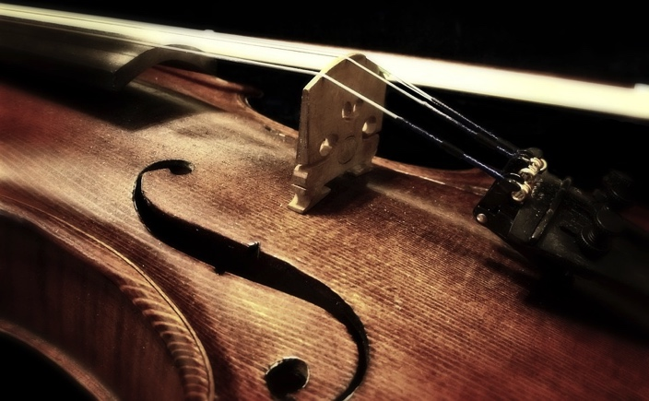
THANK YOU !

